Slide 1
MINI PROJECT YELLOW TAXI
Group 1
Gina, Andy & Zayd

Slide 2
Overall Process
Public to Personal Schema
PICKUP_DATETIME & DROPOFF_DATETIME to timestamp
Data Migration
Check Total Trips & Fare Amount Per Month
Observe the Vendor ID’s
Explore Payment Types within the data
2. Data Validation
Compute Average Fare Amount for each Payment Type
Explore the Percentage of Rides with Tips for each Month
Calculate the Cumulative Total Fare based on Service Day
3. Data Analysis

Slide 3
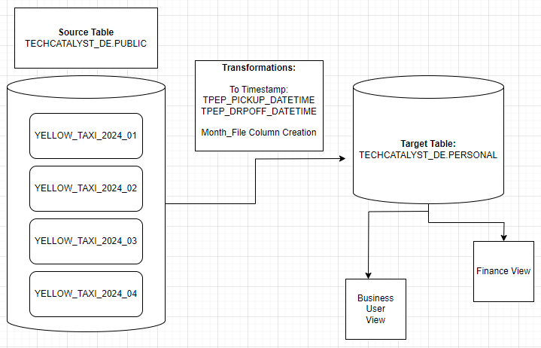
Reference Architecture Diagram

Slide 4
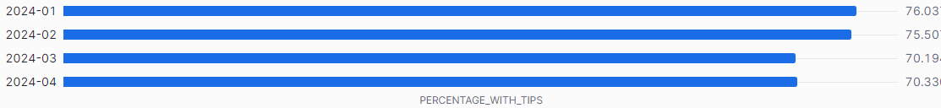
Does Service Decrease throughout the Year?
Every Month has Over 70% in Tips
Tips Decrease as the Year Progresses
Percentage of Trips with Tips Across All Months

Slide 5
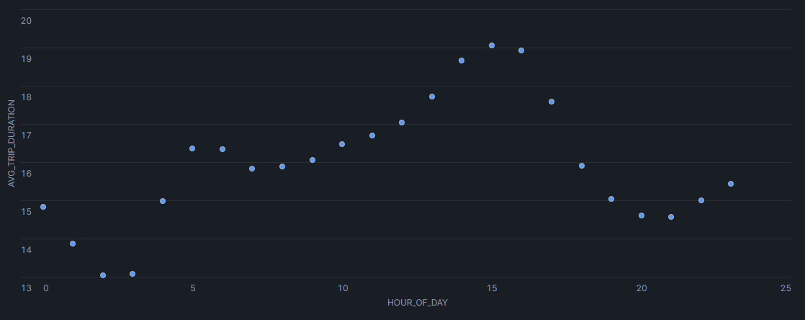
When is the Best Time to Leave?
Worst Time: 3 PM
Best Times: Before 10 AM or after 10PM
Average Trip Duration for Each Hour of the Day

